Slide 1
Predicting Song Likeability Using Spotify Audio Features
Thinkful Supervised Learning Capstone
Missy Tracy
April 2018

Slide 2
Overview
Research Questions:
Can I build a classification model to accurately predict whether or not I’ll like a song based on Spotify’s audio features?
Can I use that model to help me understand why I like the music I do?
Motivation:
Idea from Kaggle dataset
Gain insights into my personal music preferences
Work Flow:
API call → Data Processing → Exploration/Modeling
3 separate notebooks

Slide 3



Getting the Data (hard part)
Create 2 playlists:
‘Liked’ (n = 521)
‘Disliked’ (n = 517)
Attempted diverse genres in each
Install Spotipy, lightweight Python library for Spotify Web API
http://spotipy.readthedocs.io/en/latest/
Create script to pull song data from each playlist
Create loop to pull data out 100 songs at a time due to API limits
Playlist → track id
Track id → audio features
Write out to CSV for each playlist

Slide 4
Data Preprocessing (easy part)
No additional cleaning required
No missing values
No funky symbols
All numeric dtypes
Encode ‘target’ variable
Liked = 1
Disliked = 0
Concatenated playlist dataframes
Write out to master CSV

Slide 5
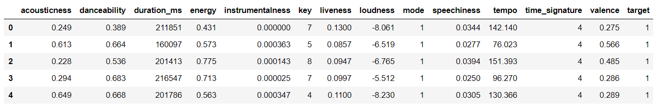
Data Exploration (fun part)
Audio Features (n = 13)
Acousticness
Danceability (tempo, rhythm stability, beat strength, regularity)
Duration
Energy
Instrumentalness (0.5)
Key (0-11)
Liveness (0.8)
Loudness
Mode (major/minor)
Speechiness (<0.33, >0.66)
Tempo
Time Signature
Valence
Notes:
Features in green already in normalized on a scale of 0 to 1, where 1 represents more of that feature

Slide 6
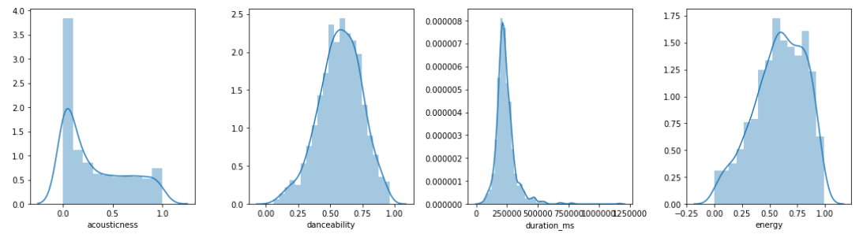
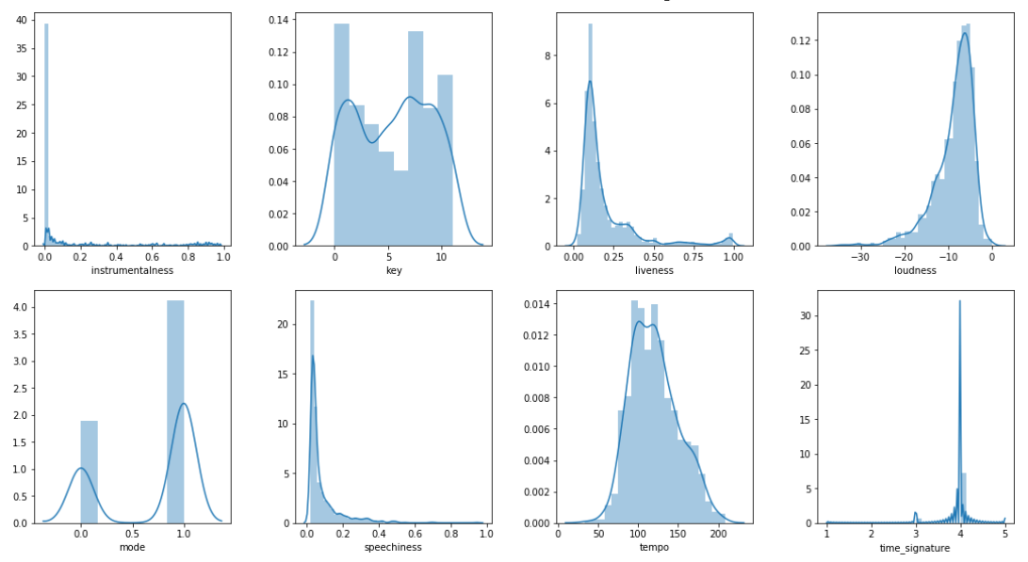
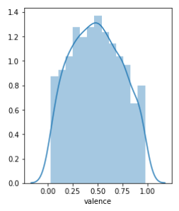
Distributions

Slide 7
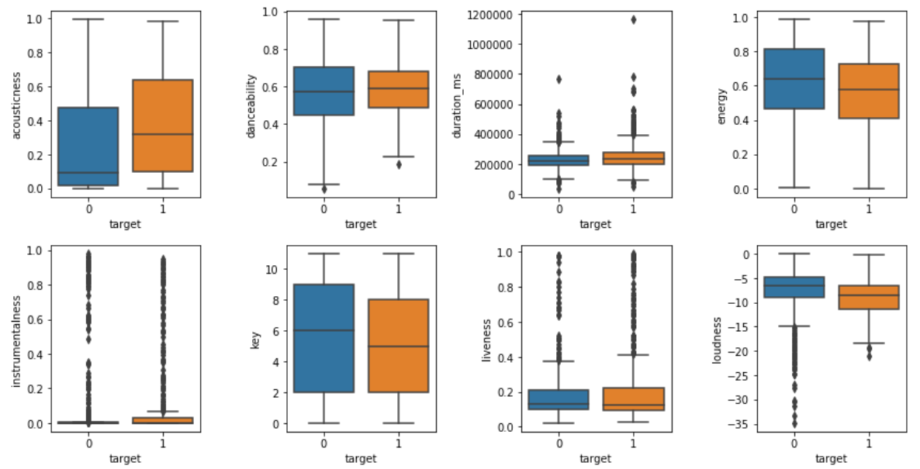
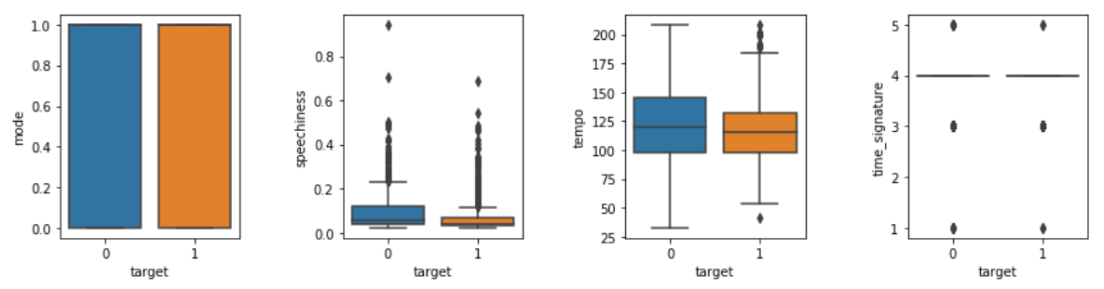
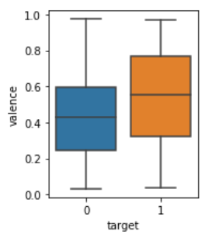
By song preference
Reminder:
Dislike = 0
Like = 1
Only variables without significant differences between groups

Slide 8
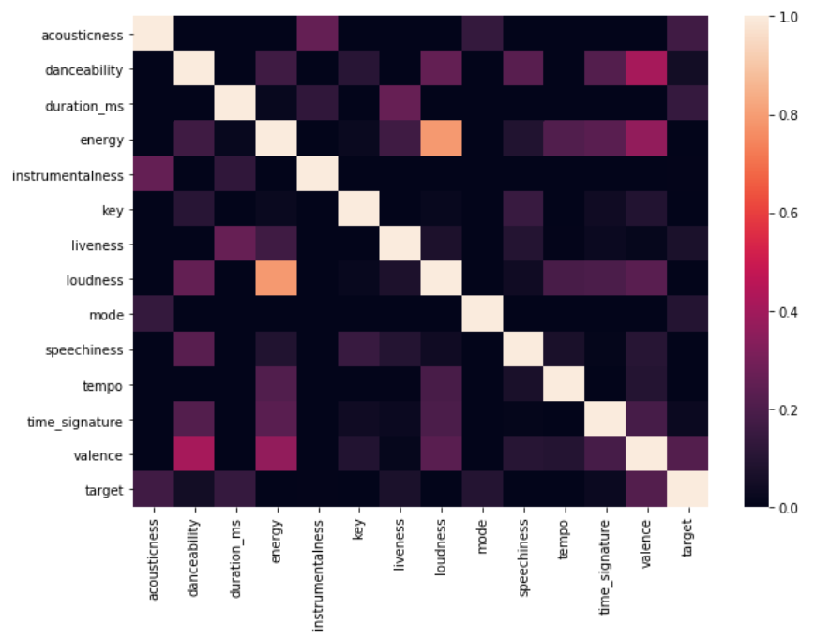
Correlations
Notes:
Minimal correlations between features due to feature engineering on Spotify’s part

Slide 9
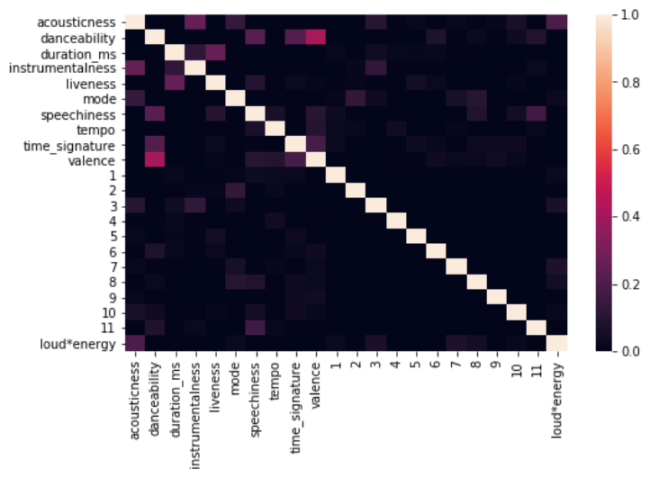
Feature Engineering
Interaction variable for loudness & energy
Dummy variables for key
Normalize all features

Slide 10
Modeling Overview
Split data into 70% training, 30% test
w/ stratification to maintain class balance
Accuracy (%) as performance metric vs. specific error types
Use GridSearchCV for hyperparameter selection
Models:
Naïve Bayes
Logistic Regression
LASSO/Ridge Regularization
Decision Tree
Random Forest
Gradient Boosted
KNN
with/without distance weighting

Slide 11
Model Performance
Model | Training Score (%) | Test Score (%) | Comments
Naïve Bayes | 64.3 | 61.9 | Slight overfitting
Logistic Regression | 67.8 | 67.9 | Best performing No overfitting
Ridge Regression | 71.3 | 66.0 | LASSO performed similarly Slight overfitting
Decision Tree | 82.6 | 61.2 | Overfitting (expected)
Random Forest | 98.3 | 65.4 | Overfitting
Gradient Boosted Random Forest | 92.1 | 65.7 | Overfitting
KNN (distance weighted) | 100 | 60.6 | Overfitting (expected)
KNN (uniform) | 80.4 | 60.3 | Overfitting

Slide 12
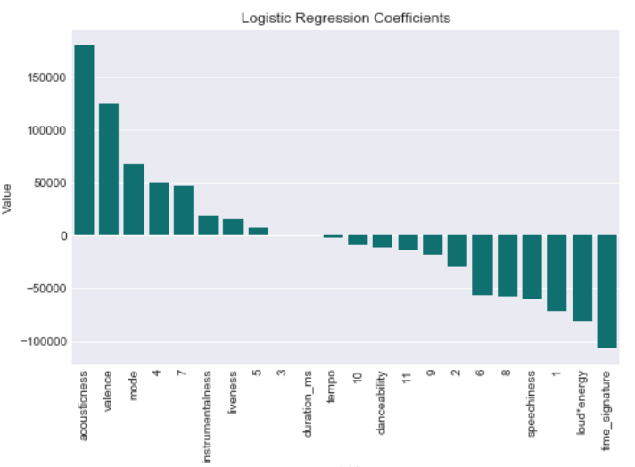
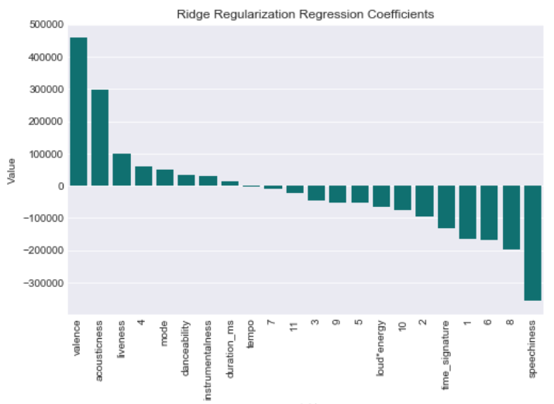
Feature Importance (really fun part)
Regression Coefficients
Strong positive correlations:
higher acousticness, higher valence
Negative correlations (more varied):
greater speechiness, higher loud*energy, longer time_signature, certain keys

Slide 13
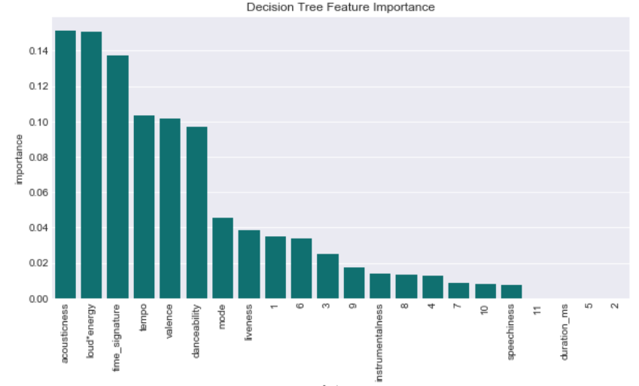
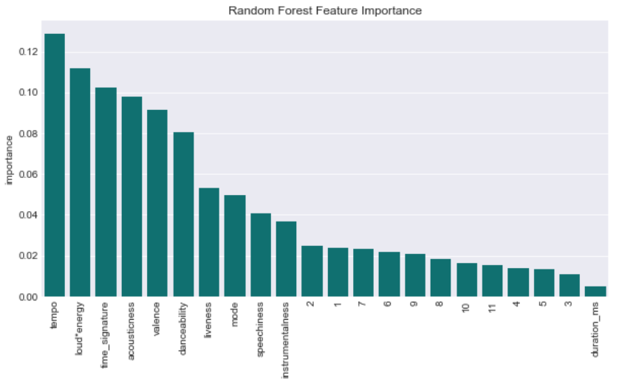
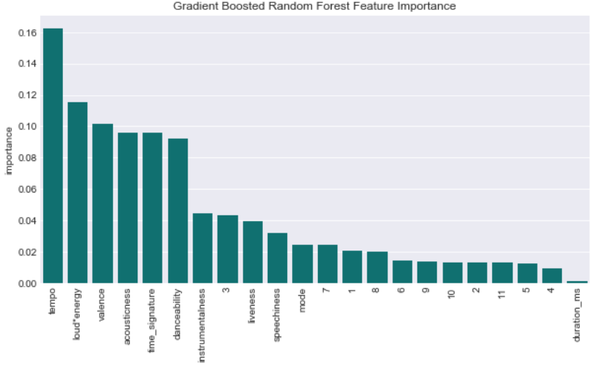
Feature Importance
Reoccurring themes:
Same top 5
Acousticness, loud*energy, tempo, valence, time_sig

Slide 14
Conclusions
Model accuracies 60-68%
Logistic regression best performing
Lots of overfitting
Accuracy limitations due in part to diversity of music & overlap of features between playlists
Prediction more difficult with increasing diversity in music
Use of stations to hone in on recommendations
Insights into my musical tastes

Slide 15
Conclusions
Room for improvement
Continued feature engineering
Try transformations & more interactions
Reduce overfitting
Challenges/Surprises
API request and data retrieval
Nested dictionaries
Lists of lists of dictionaries
Severe overfitting with Random Forest and GB Random Forest

